Slide 1
Vectorizing common HEP analysis algorithms
Author: Mentors:
Jaydeep Nandi Jim Pivarski
David Lange

Slide 2
Contents
Scalar programming and vectorization
Vectorization and GPU
Autovectorization
Vectorization of HEP analysis algorithms
Argproduct
Local reduction
Conclusions

Slide 3
Scalar Pogramming and Vectorization

Slide 4
Scalar Programming
Works on scalar ( individual elements) values of an array.
Applies an operation over the elements via a loop, usually a for-loop or while loop.
Low-level, and tedious to write.
Virtually all programming languages support scalar programming.

Slide 5
Scalar Programming
For example: If we wish to add two compatible vectors ( of same shape and castable type) A and B together and store it in C, a typical scalar program (in Python) would look like: for i in range(len(A)):
C[i] = A[i] + B[i]
It operates on each element of the arrays sequentially.

Slide 6
What is Vectorization?
Converting a scalar program to a vector program.
It is also known as Array Programming.
Wikipedia Definition: “In computer science, array programming languages (also known as vector or multidimensional languages) generalize operations on scalars to apply transparently to vectors, matrices, and higher-dimensional arrays.“
Allows applying an operation on multiple data items simultaneously

Slide 7
Array Languages
Some languages and libraries support vectorization by default. Examples include:
Python: Numpy, Scipy etc.
MATLAB
GNU OCTAVE
R etc.
Usually they compute the vectors under the hood as efficient “C” or “FORTRAN” implementations.

Slide 8
Array Languages
Recollect the addition of all elements of two vectors to give a new vector, which we implemented as a scalar code:
for i in range(len(A)):
C[i] = A[i] + B[i]
In an array language, it is quite simple to write:
C = A + B

Slide 9
So why Vectorize?
Simple to write; no need of writing loops incessantly.
Expressive, from a mathematical point of view.
But those are not the major reason for vectorising code.
Most modern CPUs and GPUs provide support for vectorised code, which runs very efficiently, operating in a SIMD style.
Can take advantage of SSE ( Streaming SIMD Extensions) and AVX instructions, which operate on 4, 8 or more data simultaneously.
GPUs take it even further: Can operate on a large number, typically in thousands, of data at once. ( More on it later!)

Slide 10
Vectorization and GPUs

Slide 11
General Purpose GPU (GPGPU) Programming
Works on Single Instruction Multiple Thread ( SIMT) architecture.
Processes multiple ( depending on the number of threads available) data elements simultaneously.
However, it requires parallel instructions, which don’t have a dependency that can create a data race.
Can be programmed with CUDA for Nvidia cards, and OpenCL for AMD cards and others.
Primarily in C; bindings exist for other languages like PyCUDA and PyOPENCL for Python.

Slide 12
Vectorization and GPGPU programming
Vectorized codes are inherently parallel. They apply same instructions on multiple data elements of the vector at once.
Is in perfect agreement with GPGPU philosophy.
Vectorized codes thus give very high speedups if operated on the GPU.

Slide 13
Autovectorization

Slide 14
Autovectorization
Modern compilers allow the vectorization of simple sequential loops into efficient SIMD instructions for CPU, typically through a compiler switch.
Some compilers which support this:
GCC: Supports through switch –ftree-vectorize or –O3 level optimization.
ICC: From Intel. Reported to be better than GCC at vectorising code.
MSVC and others.
They check if a loop is safe to be vectorised, and if it is, they vectorise the code. The list of such possible vectorizable loops fo GCC can be found here.

Slide 15
Autovectorization
As an example, consider again the addition of two vectors. A simple c loop that does is : for ( int i=0; i<length(A); i++)
C[i] = A[i] + B[i];
The corresponding assembly dump ( relevant part) is: vmovdqu xmm0, XMMWORD PTR [r9+rax]
add edx, 1
vinserti128 ymm0, ymm0, XMMWORD PTR [r9+16+rax], 0x1
vpaddd ymm0, ymm0, YMMWORD PTR [r13+0+rax]
vmovups XMMWORD PTR [rcx+rax], xmm0
Note the vector instructions in the assembly ( vmovdqu, vinserti etc)

Slide 16
Autovectorization
Advantages:
Sufficiently simpler than writing SSE or AVX instructions.
Easy to debug.
Portable.
There is however, a major disadvantage. They cannot vectorise a loop if there is a loop carried dependency.

Slide 17
Barriers to Autovectorization
The major barrier is a loop carried dependency. They are variables whose particular value depends on the order of the execution.
As an example consider the problem of finding the max value of all elements in an array A.
for (int i=0; i<N; i++)
maxval = max(maxval, A[i]);
The value in maxval at any instance depends on the order of loop execution. So, it’s a loop carried dependency, and the compiler cannot autovectorize it.

Slide 18
Barriers to Autovectorization
The assembly output of the loop is mov edx, DWORD PTR [rax]
add rax, 4
cmp ecx, edx
jl .L12
cmp rax, rsi
jne .L11
mov edx, ecx
Note the absence of vector instructions in the assembly, indicating an unvectorized loop.
The reduction operation can be vectorised, and will be dealt with shortly.

Slide 19
Vectorization of HEP analysis algorithms

Slide 20
Algorithms Considered
Argproduct
Local Reduction
And others.
For the complete list of algorithms and their detailed analysis, please refer to the complete report available here.
Note that the algorithms are not physics-specific algorithms per se, but primitives which can be used to build them. They are meant to serve the purpose of demonstrating the efficiency of vectorization.

Slide 21
Argproduct

Slide 22
Motivation: Relativistic mass and boson detection
A typical application in HEP is operating on the combinations or pairs of different particles in an event.
Higgs bosons and Z bosons decay so quickly that they're gone before they ever reach a detector. All we can detect is the electrons and/or muons, and sometimes not even that, if an electron or muon flies past the detector without entering it.
One powerful technique relies on relativistic mass: Higgs bosons have a (fairly) well-defined mass and Z bosons have a (fairly) well-defined mass (with some variation due to quantum effects, some due to measurement error). When a particle decays, its decay products have the same total energy E as the original particle (a scalar number), as well as the same total momentum P.

Slide 23
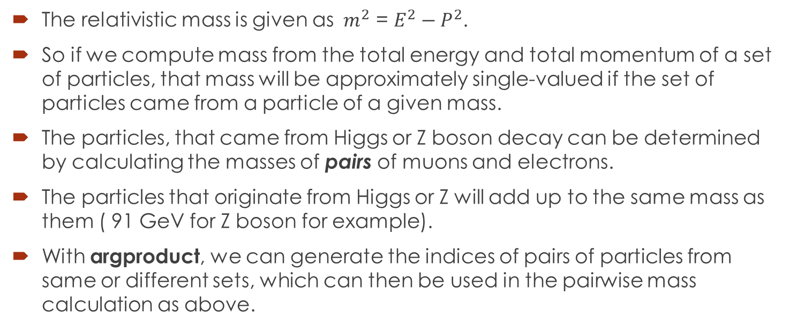
Motivation: Relativistic mass and boson detection
The relativistic mass is given as ${ m}^{2}$ = $E^{2}−P^{2}$.
So if we compute mass from the total energy and total momentum of a set of particles, that mass will be approximately single-valued if the set of particles came from a particle of a given mass.
The particles, that came from Higgs or Z boson decay can be determined by calculating the masses of pairs of muons and electrons.
The particles that originate from Higgs or Z will add up to the same mass as them ( 91 GeV for Z boson for example).
With argproduct, we can generate the indices of pairs of particles from same or different sets, which can then be used in the pairwise mass calculation as above.

Slide 24
Argproduct
Argproduct returns two arrays, consisting of the index of first element in the pair, and another array consisting of the index of the second element in the pair.
Argproduct isn’t inherently vectorizable, it has a loop carried dependency.
Some definitions:
Events: Refers to a set of particles or elements that have some property in common.
Offsets: Gives the start and end indices of an event. The start indices are given by starts, while the stop indices by stops.
Parent: An array that gives the event id for every element or particle.
Local and Global Operations: If a operation is done ithin the elements of an event only, it is local in nature. Global operations work on particles from all events.

Slide 25
Argproduct
Sequential python code:
for i in range(events):
pairs_i = 0
for j in range(starts1[i], stops1[i]):
for k in range(strats2[i], stops2[i]):
first[pairs_i] = j
second[pairs_i] = k
Note that pairs_i is a loop carried dependency.

Slide 26
Argproduct
The code can be vectorised if we have the information of
Parents array of every pair.
The number of elements in either array, say given by counts array, and the starts and stops arrays for the two particle sets.
A running index array for all the pairs in all the events.
An important thing to notice is that if we consider the linear indexed arrays as matrices, then the first and second arrays are given by the row index and column index of the matrix.
So, we just need a way to convert the linear index to matrix index.

Slide 27
Argproduct
For a simple illustration, consider the two arrays arr1 = [‘a’, ‘b’, ‘c’] arr2 = [1,2]
The output of argproduct will be first = [0,0,1,1,2,2] second = [0,1,0,1,0,1]
Which correspond to the pairs [[‘a’, 1],[‘a’, 2],[‘b’, 1],[‘b’, 2],[‘c’, 1],[‘c’, 2]]

Slide 28
Argproduct
Now, there are 3*2 = 6 possible pairs. Notice that if we have a running index array: index = [0,1,2,3,4,5]
Then first can be generated as the integer division of elements in index with number of elements in second array, given by counts, and second is the result of modulo operation on index by counts. first = index // counts second = index%counts
The operations are vectorised.
The per-event case then can be derived by giving the proper offset to the indices.

Slide 29
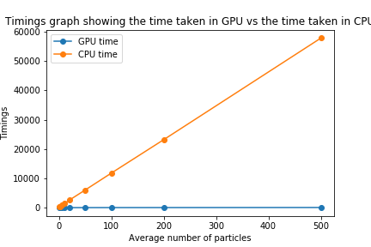
Performance Improvements of argproduct
Vectorizing the argproduct gives a high speedup, especially when considered between GPU and CPU.

Slide 30
Local Reduction

Slide 31
Motivation: Generated Reconstructed particle matching
A particular application in HEP is to find the matching between generated particles and reconstructed particles.
Generated particles are the truth or ideal values, and reconstructed particles are the detected ones in an experiment.
Gen-reco matching attempts to find which reconstructed particles belong to a particular generated particle class.
Usually achieved by minimizing an optimization criteria, which we can call the predicate function. An example of that is the minimum deltaR criteria.
We aim to find the particle pair that achieves the best value of optimization criteria in an event.
This requires local reduction, that is reduction per event.

Slide 32
Local Reduction
Reduces an array per-event. The reduction operator can be any associative operator like max(), min() or sum().
Significantly tough to vectorise.
We shall consider max(), and the rest can be simply substituted in place of max()
Sequential code
for i in range(events):
for i in range(starts[i], stops[i]):
val = max(val, A[i])

Slide 33
Local reduction
The reduction has been implemented in parallel through a modified version of Hillis-Steele algorithm.
Let us consider a single event first. The pseudocode for the upsweep phase of the algorithm is
for d=0 to (log₂n -1) do forall k=0 to n-1 by 2^{d+1} do
a[k+2^{d+1}-1] = max(a[k+2^{d}-1], a[k+2^{d+1}-1])
The algorithm proceeds by tree reducing the array elements, until a single element remains.

Slide 34
Local Reduction
To extend it to per-event case, we will again require the parents array for the data.
It will serve as a mask for the array elements, so that data isn’t accessed across events.
The modified pseudocode will then look like
for d=0 to (log₂n -1) do forall k=0 to n-1 by 2^{d+1} do if (parents[k+2^{d+1}-1] == parents[k+2^{d+1}-1])
a[k+2^{d+1}-1] = max(a[k+2^{d}-1], a[k+2^{d+1}-1])

Slide 35
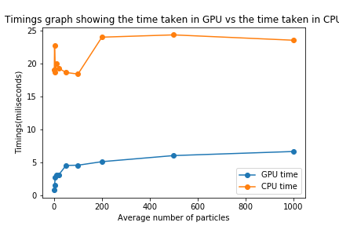
Local Reduction performance
The vectorised GPU code performs moderately well in comparison to the sequential code. The timings as a function of average number of particles are given below:

Slide 36
Conclusions
Vectorization and parallelization of code achieves superior performance over sequential implementation.
Vectorized code can be offloaded to GPU, achieving high runtime speeds.
Code remains clean and efficient.

Slide 37
Thank You!

